Slide 1
Peer Learning Community
A Monthly Systems Building Convening
June 1, 2021, 10:00 AM to 11:00 AM

Slide 2
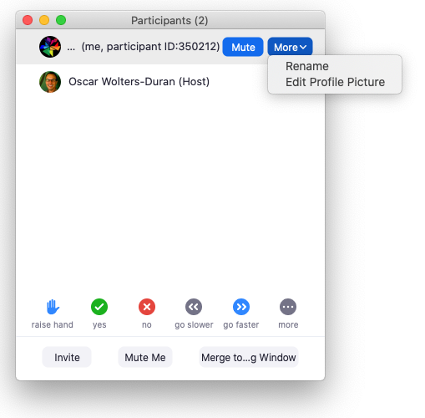
How to Rename
Open the participant panel by clicking “Participants”
Hover your cursor over your name in the participant panel.
Choose “More” and then “Rename”
Add the name of your organization after your name (e.g. Oscar - Pathways Consultants)

Slide 3
Today’s Objective
To provide a structured space for AB1111 grantees to collaborate with peers to share best practices to address common challenges.

Slide 4
Breakout Discussion
What are some areas of your AB1111 work where you would like to learn from other grantees?

Slide 5
Possible Topics for Discussion
Outreach & recruitment of participants
Retaining participants in employment, Work Preparedness
Employer engagement, Employer Requirements to work with clients, Entry-level Jobs
Staff morale, Recruiting staff, Retention
Partnering with our WDB
What’s missing?
Transition to in-person/hybrid services
Supportive Services

Slide 6
Outreach and Recruitment Notes
Define the challenge
Struggles with virtual recruitment for clients and staff who don’t have technology skills. Zoom barriers.
People not showing up--
Participants are coming in but the pipeline isn’t as steady from probation and parole.
Participants we’ve vetted don’t show up. Hard to pitch to employers folks with limited skills.
The pandemic has impacted recruitment
Challenges recruiting participants into the program.
Programs meet them where they are
How can we provide career opportunities that are of interest to participants
Interest in waste water but not automotive
Not enough entry-level positions like in Waste Water.
Retaining varifiable Documents in a timeley manner have been a huge barrier
What’s this impact it has on your clients and program?
Not enough participants to meet goals.
Has anybody had any successes dealing with this challenge? Share!
Social media marketing campaign
Break up job developers by sector. Be more familiar with employer needs. Then they can pitch it to young people better. Explain and provide insight. Deepens
Text reminders-Woof reminders. Check-in with people-personal messages.
Instagram, What’s App, Telegram. Text, email, phone call. Continuous follow up.
Brand recognition
Fun, positive attitude
Letters, home visits.
With respect to outreach and recruitment, we transitioned two of our programs away from cubby holing participants into specific industries to a more human-centered approach that helps participants value opportunity, connect their desires to a pathway and then pursue the necessary skills and development to achieve their self-determined desires. This has been extremely effective.
I love the idea of the drive thru outreach

Slide 7
Retention and Participant Preparedness Notes
Define the challenge
Retention and Particpant preparedness?
Retention challenges from population barriers and pandemic.especially with returning citizens
Housing and other supports like cell phone access
Hard to keep in touch wih them, looking forward to opening up
Motivation level is shot and low
IWD - work readiness is really tricky due to shift in employer expectation in digital literacy
Timelines of the grant vs reality of
Turnover within aency
What’s the impact it has on your clients and program?
The timeline is greatly impacted and the challenges and need are not necessarily training related, the need is supportive services
Processes take longer even/especially if they are digital
Waiting for June 15
Motivation an issue with plenty of employers looking
Has anybody had any successes dealing with this challenge? Share!
Parking lot resource fairs, recruitment
Targeted virtual job fair
Outdoor paid workshops
Any and all means of truly connecting with people, fellowship, social mixers with food
Cell phone

Slide 8
Topic 3 - Employer engagement
Define the challenge
Employers stigmatize clients with barriers (incarcerated, homeless, etc.) Build empathy!
Competing against more qualified candidates
How to build incentives for employers to participate
Employers not supportive - how to find more suitable placements
More opportunities for direct hire
Not “engaging,” no reciprocation with employer.
Harder to get employers to hire without minimum work experience - and few internships
What’s the impact it has on your clients and program?
Clients understanding how to interview - sharing info to early? Clients get discouraged.
Another thought along these lines pertains to the manner in which we engage employers. With respect to our participants, we intently focus on providing Whole Person Care Human-Centered Design development that is purpose- and outcome-driven. However, we tend not to do the same with employers to help them help us.
Has anybody had any successes dealing with this challenge? Share!
We need to truly build relationship for 6-9 months, before hiring
Engage employers in participating with clients (not directly related to hiring)
Ask for internship and externship opportunities - and to invest in clients, contributing to wages
Retention workshops - e.g. reliable, giving them employer viewpoint; peers sharing and mentoring
14 day foundations workshop - put self into participants shoes and learn the business -

Slide 9
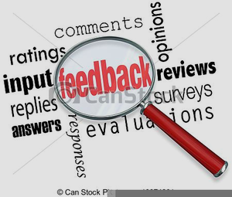
What’s Next?
Announcements: SLACK Channel Ready!!!
Next Meeting: Breaking Barriers Community of Practice
June 22-23, 9:30-12:00 PM
This document is yours to keep. We’ll post the link to the slideshow in the chat. https://docs.google.com/presentation/d/1sqDApacpoHpQvvaWBmbuygPkwrlO-haPcR-n6wrBx4E/copy
Give us your feedback: https://www.surveymonkey.com/r/AB1111May-June
Chat - Share something you learned or appreciate from today in the chat but don’t hit “enter” until the count of 3.
Please help us improve this PLC! Please open the link posted in the chat and take a few minutes to complete the survey.

