Slide 1
Implementation of California’s Homeless Hiring Tax Credit
California Workforce Association board meeting
January 2023

Slide 2
Background
2021’s Budget bill AB 150 included California’s brand new tax credit, which allocated $30 million for a reservation for businesses who hire individuals experiencing homelessness.
The credit is available for taxable years beginning January 1, 2022 through December 31, 2026. Employers may receive $2,500 to $10,000 in tax credit per eligible employee based on hours worked in the taxable year. Employers may claim up to $30,000 of credit per taxable year.
To be eligible, the employee must have a certificate issued by a certifying organization. Employers must make a credit reservation with the Franchise Tax Board to claim the credit. A total of $30 million of credit is available annually.

Slide 3
What makes a business eligible?
To claim the HHTC, employers will need to:
Obtain a certificate for each eligible employee from a certifying organization.
Pay wages equal to or greater than 120% of the state minimum wage.
Make a credit reservation within 30 days of the date of hire.
Employer can get a reservation on FTB homeless hiring tax credit webpage. https://www.ftb.ca.gov/file/business/credits/homeless-hiring-tax-credit/index.html

Slide 4
What is Homelessness?
Homelessness is defined as living in a place not meant for human habitation, in emergency shelter, in transitional housing, or exiting an institution where a person temporarily resided. Homelessness is subcategorized and defined by different levels based on timed conditions in an unstable living arrangement.
“Homelessness can be like a swimming pool. There’s a deep end and a shallow end. For the people who are struggling with tents or who are not housed, they’re at the deep end of the pool. People in the shallow end may have a roof over their heads; they might be couchsurfing; they might be in an RV; they might be housesitting but they’re still homeless.”
Guitar Whitfield

Slide 5
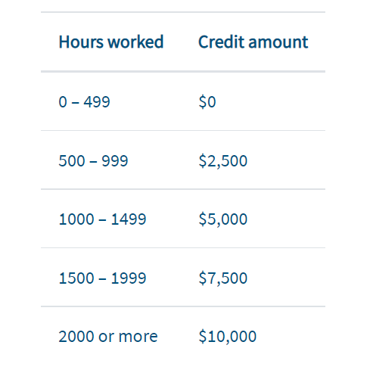
What makes an employee eligible?
Be currently/recently homeless (within 180 days of hire) or be receiving services from a homeless services provider,
Receive a certificate through a certifying organization. The certificate expires 1 year after issuance.
This certification will be issued by a continuum of care or other homeless service provider, that can verify through California’s HMIS (Homeless Management Information Systems) that the individual is receiving services and meets the statutory definition of homeless
The credit amount is based on the number of hours worked by the eligible employee in the taxable year.

Slide 6
How are these connections made?
California’s 45 Local Workforce Boards all run Business Services, which have relationships and strategies to meet the needs of employers in their local labor markets.
Locals also work closely with community services and other program providers, who can help assist with eligibility requirements and connections to homeless services
An employer looking for help sourcing talent or applying for the reservation can reach out to a local workforce board by connecting with their business services on a county basis. A list of business services contacts can be found here
Employers can also reach out directly through a one-stop career center. Find your closest brick and mortar Job Center through this link

Slide 7
HHTC Overview

Slide 8
Tips for Working with your Local Continuums of Care & Homelessness Services Providers
Continuums of Care
Regional or local planning body that coordinates housing and services funding for homeless families and individuals in California
Entity is established as a requirement for federal funding, Cal ICH block grants
Many already doing work to connect with employment opps
Establish connects early and identify who to contact with opportunities
Be patient, a lot going on CoCs and systems are strapped for resources/capacity esp during COVID

Slide 9
Follow up links
For questions regarding connections to Local Workforce Boards and business services, please see the California Workforce Association's website
For questions regarding connections to Continuums of Care and other Homeless service providers, please see the link through the Business, Consumer Services and Housing Agency website
For questions regarding the credit reservation system please see the Franchise Tax Board's website

Slide 10
We want to hear from you!ible?
Open discussion
What are some obstacles that your offices, local Workforce Development Boards, local Continuums of Care or others have faced when promoting the use of HHTC?
Is there any way that our office may help? Would more webinars, tools or collateral material be beneficial?

Slide 11
Questions?

